Slide 1
Becoming a New Policing Blueprint community
Public safety and Thriving Communities
A model for dignity- The Faith Leaders Roundtable- Rochester, NY

Slide 2
Our Current policing philosophy
Clear and consistent messages of offender accountability and victim safety believed to reduce violence. (This must include officers as well as community members.)
Sure and swift consequences for offenders can reduce recidivism and the severity of future crime.
What is our current philosophy if the perpetrator is a public safety practitioner under the current blueprint?

Slide 3
Historical context is essential to knowing where to go in a new design to be a trendsetter
1819 blueprint for policing created in Rochester no longer serves us as a community and new blueprints are created all the time.
2007-2010 Blueprint for safety created and tested in St. Paul, MN focused on Domestic violence
A blueprint for a safe and just America https://thejusticecollaborative.com/about/blueprint/
Epic initiative http://epic.nola.gov/home/

Slide 4
A New Blueprint for Public Safety and Thriving Communities is needed
“The current blueprint for policing was designed in 1819 from slave patrols” – this pattern was disseminated throughout America to attend to white anxiety, protect white property and wealth, while monitoring people of color”
A new blueprint will end dehumanization
Decriminalize extreme vulnerability
Interrupt the incarceration crisis created in communities of color
Establish accountability for police abuse, excessive use of force, and killing of People of Color”
It will ask the right questions and get the right results for defining public safety and building thriving communities.

Slide 5
Let’s Re-imagine It! Addressing criminal activity is not the same as creating public Safety
Redefining Public Safety is essential in coordinated work across and within agencies. Built- in systemic accountability increases protection and public safety
Let’s go from poor outcomes to improved outcomes by not treating social/racial problems as criminal ones, requiring a violent or surveilling response
White supremacy patterns in criminal justice is the problem! It treats black and brown This must end.
We must redo and rewrite state laws giving permission to such patterns.
A justice system that practices injustice is incongruent with its mission

Slide 6
Redefining Public Safety
Means leaving traditional narratives and responses to crime!
Focuses on investing toward thriving communities & positively impacting communities of color .
Means not funding police under a catch all model! (keeping the peace, homelessness, prostitution, theft, gang violence, drug dealers, school security, domestic violence, and every unexpected crisis.)
Means that public safety can exist outside of law enforcement interaction and involves the full health and safety of a community.
Requires trust, attending to trauma, and accountability.

Slide 7
To develop a basic statistical picture for our community with a new blueprint means understanding:
Calls to 911
Proportion of police work and work that proportionately should remain with community members/organizations
Prosecution & probation data based on race & class
# crisis calls and outcomes- data from community-based organizations
Vulnerable community member complaints of wrongdoing in policing and outcomes.
Assess scope & scale of community & policing success and violence in local neighborhoods
Differentiation of calls that require community investment strategies versus a policing response.
Ultimately, we must redefine public safety to reflect an end to racial targeting with a collaborative decision matrix for justice .
Institute mandatory reporting by hospitals of police interactions
Rewrite section 3 of Officers Law as well as ending qualified immunity
Dismantle the European paradigm for service delivery to people of color in policing and public safety

Slide 8
Essential commitments of a New Blueprint Community
Political will and community effort!
New mission and vision design through a collaborative process
Engage in self examination and problem solving of the old.
Establish foundational principles that transform an authoritarian model into a servant model of public safety.
Redefining central roles for public safety practitioner outcomes
Collaboration with community for community-based solutions, accountability, and advocacy

Slide 9
New mission and vision statement
Mission: To accelerate an end to racism in policing by focusing on public safety practitioners and partnership models that create thriving communities for all.
Vision: To create a racially just policing blueprint that fosters community trust, investment, and mutual partnerships.

Slide 10
Six Principles
1. Adhere to commitment of equity, transparency, and justice as we build an interagency, inter community approach with collective intervention goals devoid of authoritarianism.
2. Build in commitment to end police abuse by reassigning roles that could be attended too by community members who are trained in intervention and understanding the community it serves.
3. Recognize that systemic violence is a patterned crime like all other crimes and that it requires continuing engagement with victims and offenders as well as sure and swift consequences
4. Refunding the community through defunding policing budgets is essential for additional support services to create public safety.
5. Exhibit the power of the criminal justice system by sending consistent messages of help, accountability, & partnership to create a thriving community.
6. A commitment to act in ways that reduce unintended consequences and the disparity of impact on victims and offenders throughout the community.

Slide 11
7 Steps behind the Principles
1. Rewrite the blueprint that decriminalizes social problems, removes all barriers to minority hiring, officer accountability and privileges that place them above the law while prioritizing thriving communities.
2. Urge and create incentives for transparency of information sharing imperative to the community.
3. Design a mandatory shared approach between public safety and criminal justice inter agencies along with the communities they serve to develop collective intervention goals in building a racially just servant model.
4. Support defund/refund by assigning 40 % of the current policing roles to community members of color who are trained in intervention, de-escalation, referral, service delivery, and self defense protocols to address social problems.
5. Collect data through surveys and complaints on patterned systemic violence in community policing, negative unintended consequences and disparity of impact. Make hospitals mandatory reporters.
6. Re-allocate portions of policing budgets into a Community Chest that resources communities of color toward public safety as a redress for historic harm.
7. Focus on harnessing the power of the criminal justice system to send cross cultural messages of public safety for all through developing a collaborative decision matrix for justice.

Slide 12
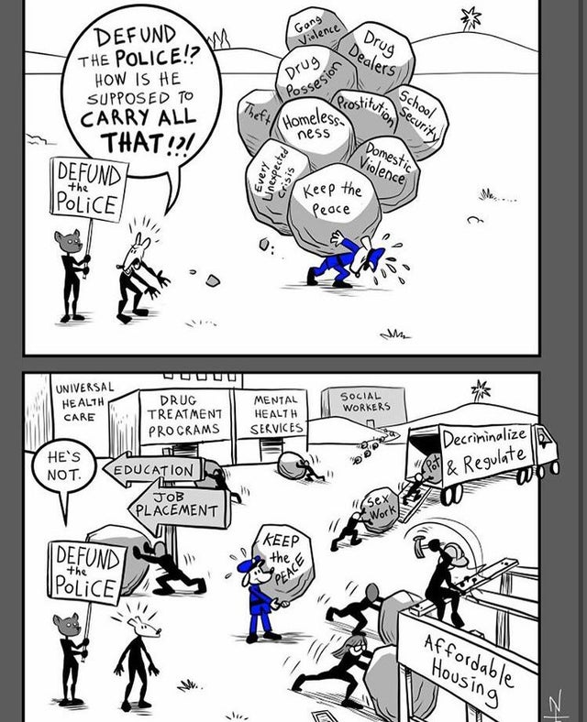
10 Comments
Neal Skorpen cartoon on defunding the police

Slide 13
Becoming a Blueprint community requires:
Currently functioning interagency group buy in and cooperation
Ongoing leadership by advocates and system actors
Coordinated efforts for equal justice and public safety
Agencies understand this is a process of assessment and change
Leadership and commitment for systemic change to explore, prepare, assess practice, rewrite policy, implement & monitor
Spirit of trying new things and commitment to a unite approach and shared purpose

Slide 14
Approach:
✓ Put Stability within everyone’s reach!
✓ Stop making poverty into a crime!
✓ Treat kids like kids!
✓ Allow people to grow and change!
✓ Treat addiction and Mental illness like medical issues!
A document:
✓ Collection of data to understand and address the circumstances that cause violence to erupt and spread.
✓ Community of color led agencies and perspectives on public safety must be included.
A process:
✓ Provide targeted resources to people who are victims of serious physical harm.
✓ Include also those who are most at risk of being a future perpetrator or victim of violence.
The why of Approach, Document,
& Process

Slide 15
The faces and names behind the numbers
https://interactive.aljazeera.com/aje/2020/know-their-names/index.html

Slide 16
The New blueprint will….
Have a coordinated justice system response to public safety and thriving communities that…
Decriminalizes people of color for being black and poor
Responds more quickly and effectively to violent crimes when needed, expanding the definition of violence to include systemic offenses.
Enhances capacity to stop violence, live into its values and hold itself accountable to build trust across the spectrum while saving lives.
Provides a fully articulated CCR( contact and control room hub of communication across the force that works via plan and method.
Address non-emergency enquiries via telephone, email, text, social media and facsimile
Broadens the concept of public safety evidenced by appropriate contact with officers and staff on the ground.

Slide 17
Approach- Document - Process
Approach: shared, coherent way of thinking about public safety and types of intervention that are effective toward thriving communities
A document: collection of interagency practices designed to guide our collective approach. They must include community of color led agencies and perspectives on public safety.
A process: ongoing evaluation and adjustment of practices as needed
Across the legal system Representatives from communities of color must have a seat at the table to approve, challenge, or sign off on decisions that impact their community

Slide 18
In conclusion a new blueprint is one that commits to…
Asking the right questions about public safety and thriving communities with a single, overarching policy of equity.
Partnerships with community- based advocates with best practices grounded in equity research r/t policing and public safety
All agencies cooperation that identify, document, act on risk/danger/community investment protocols
Employs victim / perpetrator engagement strategies that are humane and maintains dignity
Pays attention to and is aware of disparity of impact and unintended consequences from policing and public safety
Inter- and intra- agency monitoring built in =ongoing problem solving among public safety practitioners with community agreements

Slide 19
In conclusion a new blueprint is one that commits to…
New forms of documentation and communication
Information disseminated about risk/danger of certain officers/suspects/ and crimes across system in new ways.
Independent police accountability board with full power to engage the system.
Develop new tools and links for officer support and decision making.
Ending the use of over policing & overcharged crimes in communities of color.
Mandatory Racial Justice training
Improve investigative crime solving percentages & the use of restorative practices where appropriate.

Slide 20
What steps need to happen to make it a reality?
Asses local needs and create plan
Secure Funding and support for developing a new model from the state and federal resources
Work with an array of partners that include the structural racism commission, social justice leaders, Youth, community members, faith community leaders, retired officers who have a critical analysis of the problem, & political leaders, like Mayor and City Council who are stake holders
Call on state legislators to rewrite laws ensuring that the legal framework does not impede accountability for law enforcement.
Remove credit score requirements as barrier to hiring and replace with lie detector tests as needed

Slide 21
What steps need to happen to make it a reality?
Understand the terms and goals of public safety
Take inventory of what city and county resource are available for the new design.
Reassign roles for policing and community in partnership dividing up allocated budget funds
Know how many officers you need on the ground to keep a community safe bases on wards, districts, etc. and crunch the numbers
Negotiate buy in from police union and change necessary state laws that impede changes needed

Slide 22
Resources
https://www.sentencingproject.org/wp-content/uploads/2016/05/Expanding-Public-Safety-in-the-Era-of-Black-Lives-Matter.pdf

Slide 23
Public Safety Support services
Trauma informed care training, Drug treatment programs, Mental Health Services, Social Workers, Education, Living wage Job placement & training, affordable quality housing, Universal Health Care, Cultural Led Youth Services, entrepreneur programs etc.
Create new frameworks for pretrial release conditions, and bail reform that reflect needs/risk/danger/inequities & include victim input where possible; swift response to violations that are restorative
Position probation to differentiate context /severity & provide community accountability for how it functions as support
District Attorney’s office – institute community accountability and input as it relates to charges brought disproportionately and those used to suppress protest calls for systemic justice thwarting needed changes.
The police accountability board
More diversity in the criminal justice system, checks and balances along with community input that is detailed to judges about pattern, type, scope, & severity of alleged crime!
Court & seized funds returned to community for additional resources

Slide 24
Central Role for Advocates
Work
Work together to develop blueprint, policies, procedures, protocols
Foster
Foster collaboration of faith community/social justice community/retired police officers/law professors/political leaders.
Direct
Direct engagement with community and those who hold system power
Understand
Understand full scope and scale of police brutality, surveillance, and community violence in black and brown neighborhoods
Access
Broad access to victim’s stories, police histories, and systemic collusion
Create
Create new pathways for righting judicial wrongs within expedient timetables.
Ensure
Ensure Decisions and judgments are to be based on a more complete understanding of the culture, needs, risk, impact, and context of a particular case.

