Slide 1
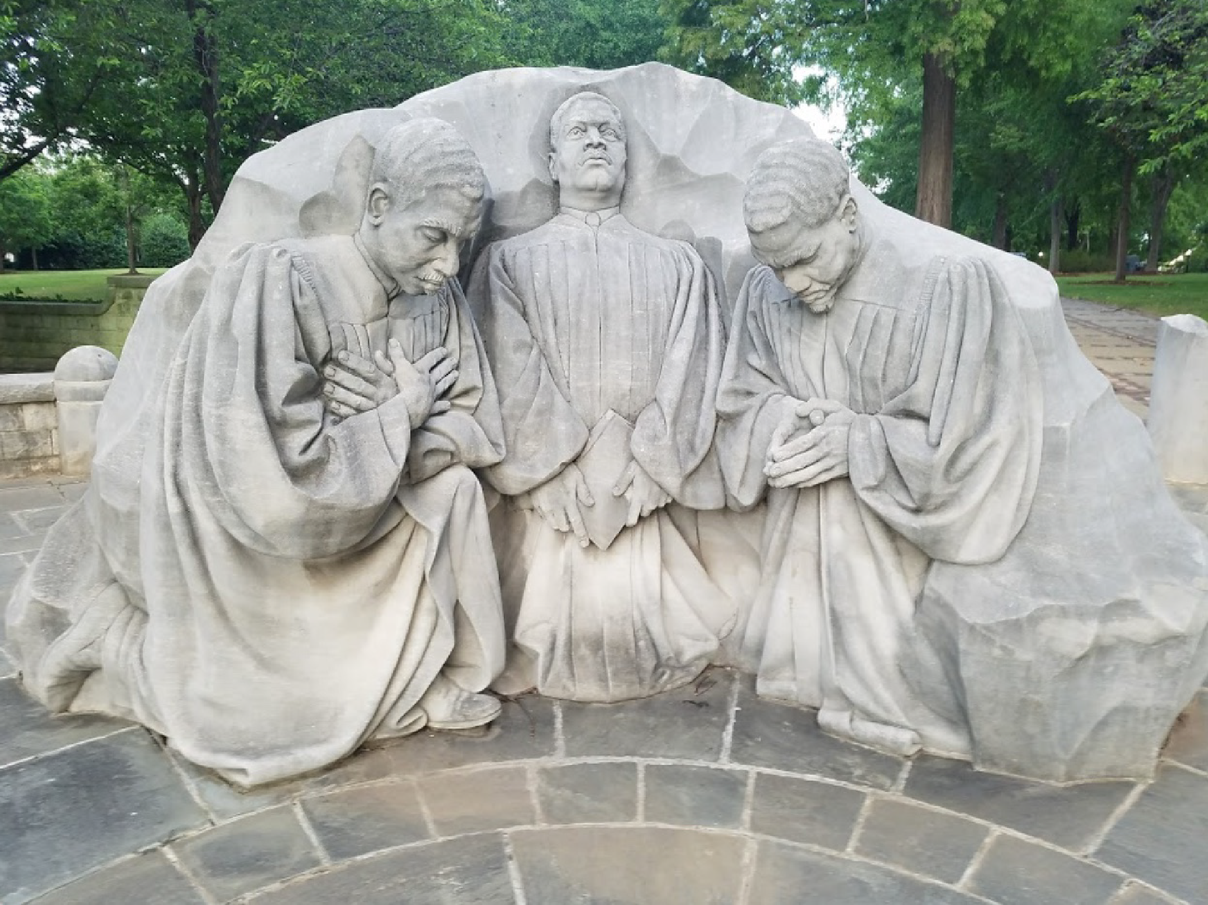
From Paper to Park
Rochester’s Civil Rights Park
From Paper to Park
Rochester’s Civil Rights Park

Slide 2
Inspirations
Race Convoy with Spiritus Christi (SPARC)
  Columbus
  Birmingham
  Selma
  Montgomery
Civil Rights Museum
Kelly Ingram Park, Birmingham
Rochester Civil Rights Park

Slide 3
Local Civil Rights History
Harriet Tubman
Frederick Douglass
Dr. Charles Lunsford
Mildred Johnson
Lena Gantt & David Gantt
Ruth Scott

Slide 4
Local Civil Rights History
Rev. Raymond Graves
Dr. Walter Cooper
Dr. John Walker
Ursula Burns
Malcolm X
Alice Young

Slide 5
Local Civil Rights History
Rev. Marvin Chandler & Rev. Franklin Florence- integral in the launch of the FIGHT organization.
Played a key role in FIGHT’s negotiations with Eastman Kodak to develop a job training program for the large number of unemployed black Rochesterians.

Slide 6
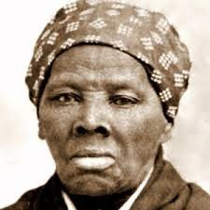
Harriet Tubman
Helped many escaped slaves migrating to Southern Ontario
Settled on a small plot in Auburn, NY (given to her by Senator William Seward
Worked with suffrage movement hero’s Susan B. Anthony and Emily Howland
Keynote speaker for first meeting of the National Federation of Afro-American Women

Slide 7
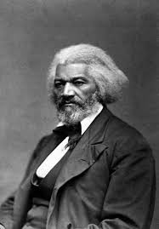
Frederick Douglass
Served as Chairman at the National Negro Convention in Rochester advocating for the “Declaration of Sentiments” for Negro rights!
Editor of the North Star
First black person to have a statue of recognition in the
U.S.A. – Highland Bowl
Early advocate for school desegregation in Rochester

Slide 8
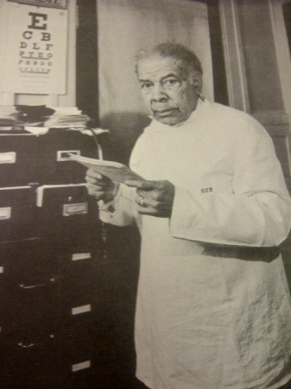
Dr. Charles T. Lunsford
Pioneer of civil rights for African- Americans
First medical practice owned or operated by an African-American in Rochester
Fought Kodak’s racial discrimination in hiring minorities
Confronted the Red Cross regarding the refusal of blood donations from African-Americans
Confronted the YMCA for denying a room to a well known black singer

Slide 9
Rochester History
Edited by Blake McKelvey, City Historian - 1959
Rochester’s growth, stimulated by the building of the canal had passed the 5000 mark by 1825 and included most of the 263 Negroes then resident in the county. Their number was sufficient two years later to prompt a gala feast on July 5 to celebrate the abolition of slavery in New York State.

Slide 10
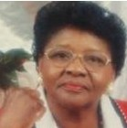
Mildred Johnson
Dedicated and community activist with her work for Action for a Better Community and FIGHT.
Court advocate; worked with defense lawyers and was instrumental in getting Monroe County to establish the Public Defender's Office.
Served as liaison between city officials and residents during 1964 race
riots. -
Founded the Negro Information Center in her home to help people find jobs; later named The Virginia Wilson Interracial Information and Helping Hand Center in honor of her mother.

Slide 11
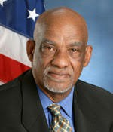
Lena Gantt & David Gantt
One of first directors and founders of Action for A Better Community & mother to Assemblyman David Gantt
Help to establish Northeast District Council Rochester Health Network
Anthony L. Jordon Health Center
Active in Hanover Houses projects for poor black families

Slide 12
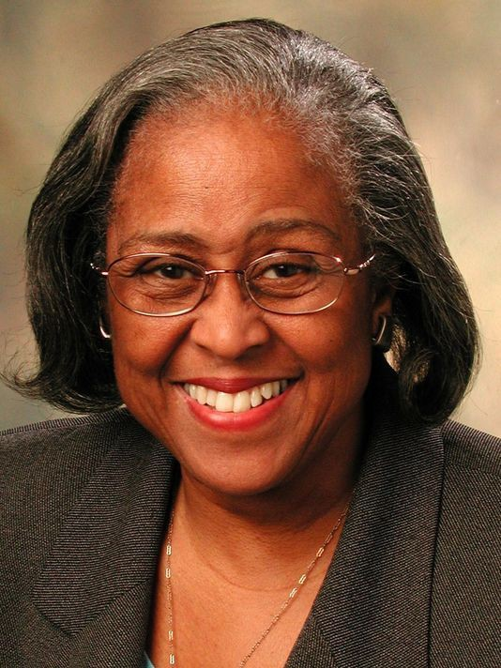
Ruth Scott
A pioneer in Rochester politics for women
First African American woman elected to City Council in 1977
First A.A. women City Council president in 1986

Slide 13
Rochester History
Edited by Blake McKelvey, City Historian - 1959
Slave hunters from the South occasionally tracked fugitives to Rochester. A girl named Ellen who was seized by her master’s agents in Rochester in the 1800’s, though released for a time…. She was recaptured and carried off by force and finally escaped, according to reports, only by cutting her own throat.

Slide 14
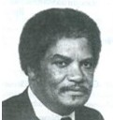
Rev. Raymond Graves
A pastor, activist and community organizer who challenged police brutality against the black community fighting for equality.
He helped spearhead the Anti-Drug movement, the Father's Program, the Job Placement program for the unemployed, and a Community Center.
He also helped establish ministries for the mentally ill, AIDS victims, drug addicts and street prostitutes. As an outspoken activist he provided counsel for many community programs and civil action groups

Slide 15
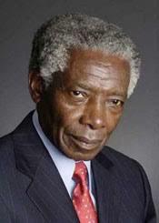
Dr. Walter Cooper
Eastman Kodak Research Chemist
Regent of the State of New York
Civil Rights Activist
Rochester NAACP branch president
Co-founded Rochester branch of the Urban League
Board member of the Baden Street Settlement

Slide 16
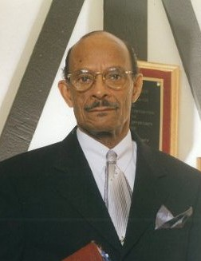
Dr. John Walker
Teacher, activist, historian and local scholar.
Led historical protest and lock in at Colgate Rochester Divinity School in 1968 forcing the school to establish the first black church studies program in the U.S.

Slide 17
Rochester History
Edited by Blake McKelvey, City Historian - 1959
Influenced by Frederick Douglass protest and injection of a new issue of discrimination regarding segregated education of negro children,
… in 1857 Rochester finally recognized the stupidity of segregation and admitted all Negro children to the regular city schools.

Slide 18
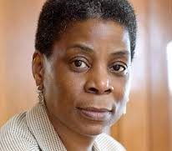
Ursula Burns
The first black-American women CEO of a Fortune 500 company – Xerox
Appointed by President Obama to Lead the White House National STEM program from 2009-2016
Launched a new diversity initiative in 2015 to bring greater diversity to the tech world at Xerox.

Slide 19
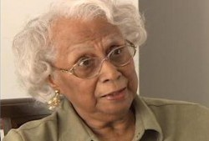
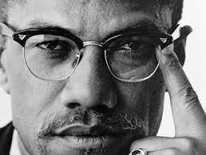
Constance Mitchell & Malcolm X
First Black woman elected to Supervisor in a male dominated racialized culture.
Began a school and tutoring program for poor blacks in her living room to pass the racist literacy test requirements for voting in Rochester.
Hosted Malcolm X in her home for speeches that shaped local political activism

Slide 20
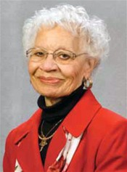
Alice Young
Pioneered as an African American educator for 4 decades (1952)
Districts first African-American teacher, Vice Principal, and Principal
Supervised first integration program including the Urban Suburban Program
Helped to establish Monroe Community College (1961)

Slide 21
Rochester History
Edited by Blake McKelvey, City Historian - 1959
Miss Patience Johnson, the first Negro to graduate from the Rochester High School in 1878, became a teacher at nearby Lima; her brother Harry was perhaps the first Negro to practice law in Rochester, followed shortly in the early nineties by Charles Lee.

Slide 22
Rochester History
Edited by Blake McKelvey, City Historian - 1959
“Throughout our history, stalwarts of equality and justice have risen throughout the generations. We need to study their methods, highlight their accomplishments, and retool their methodologies to address today’s challenges.”
Ruth Scott
D&C Feb. 2014

Slide 23
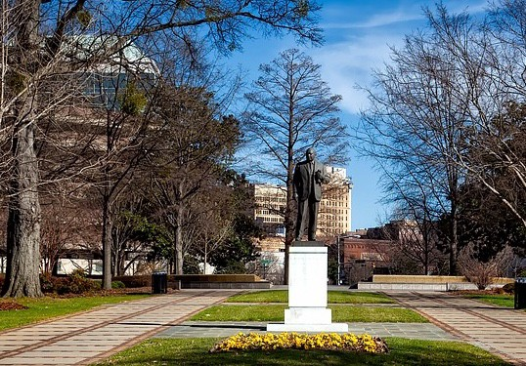
Our Vision

Slide 24
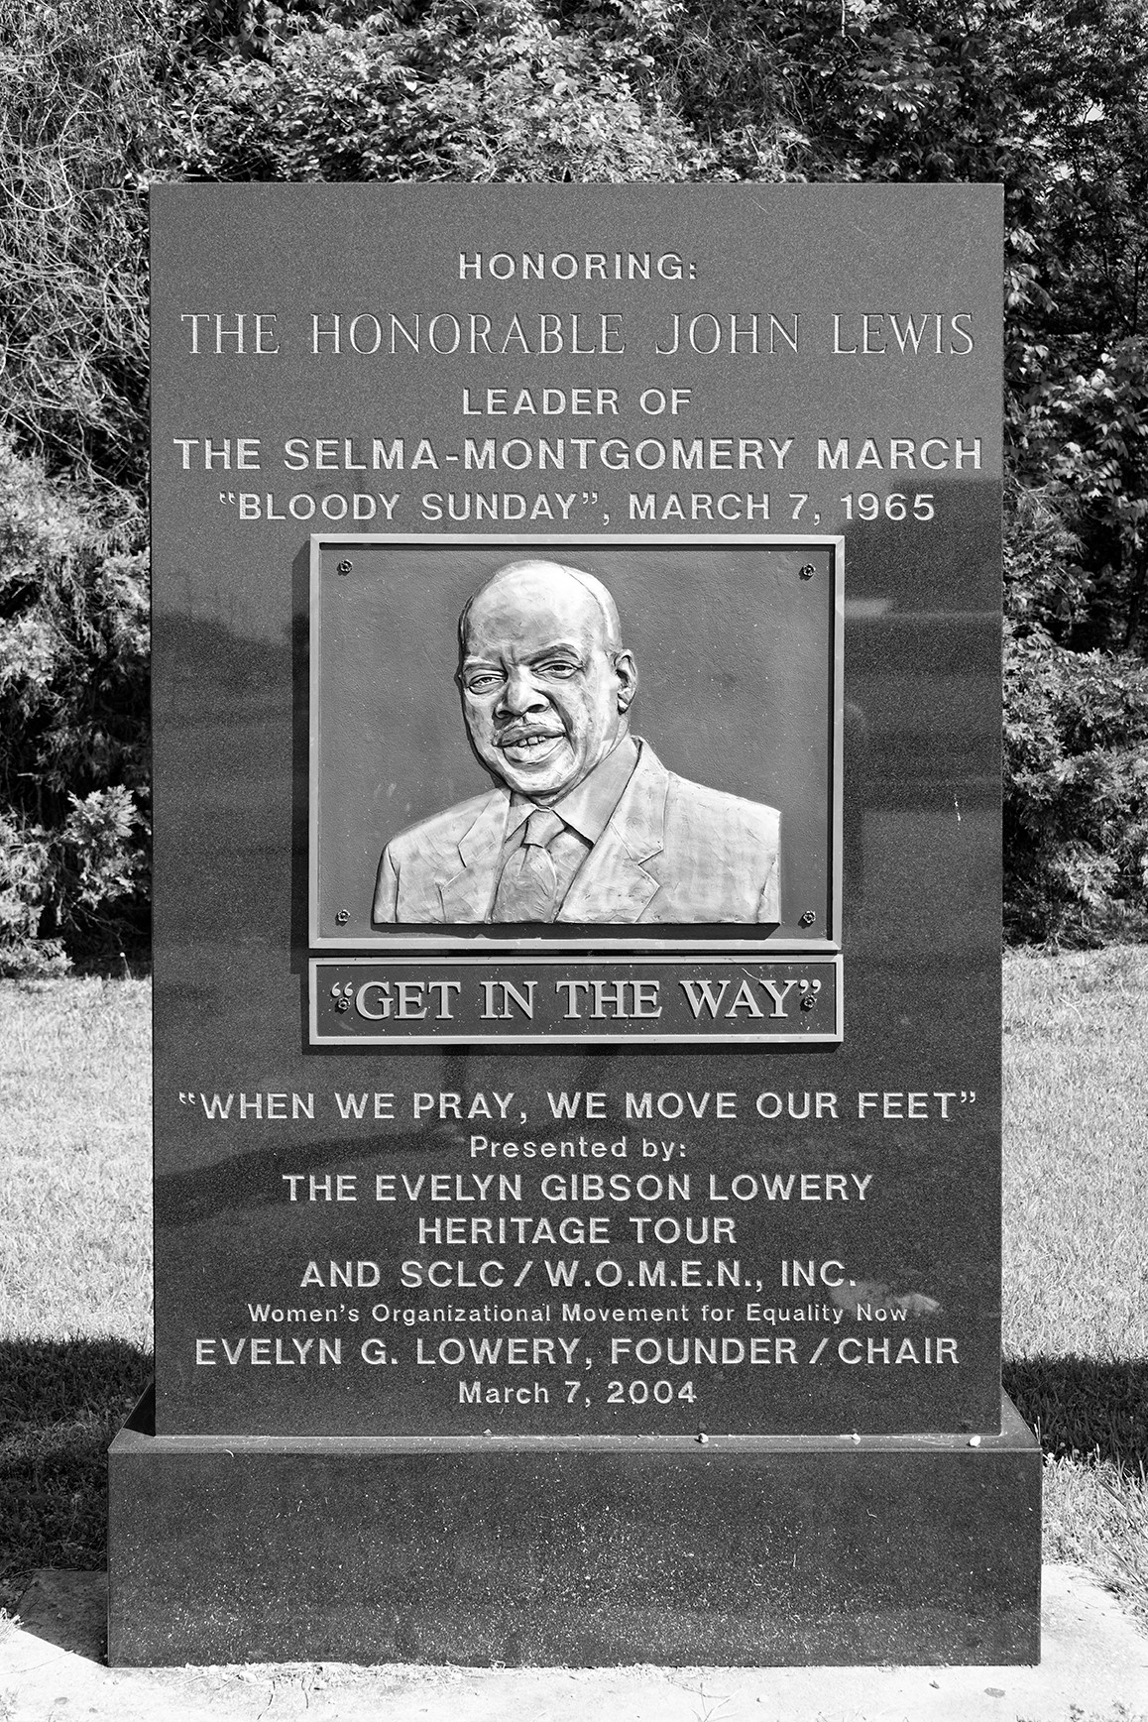
Our Vision

Slide 25
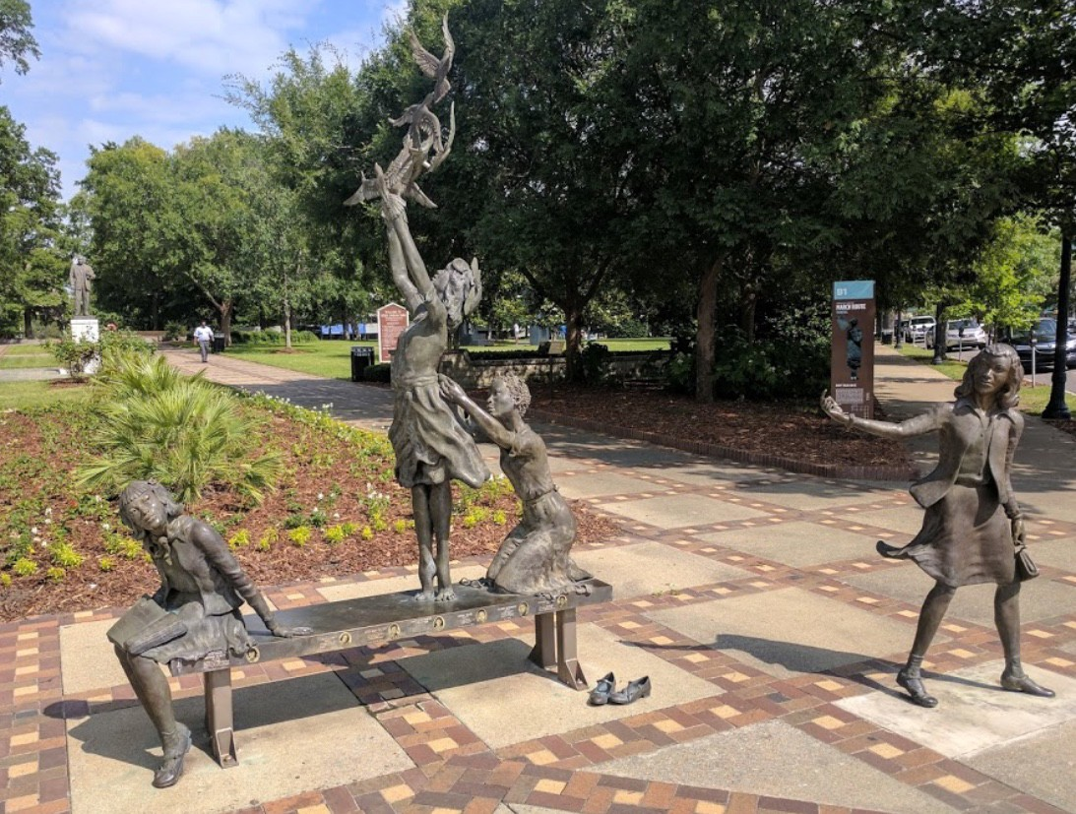
Our Vision

Slide 26
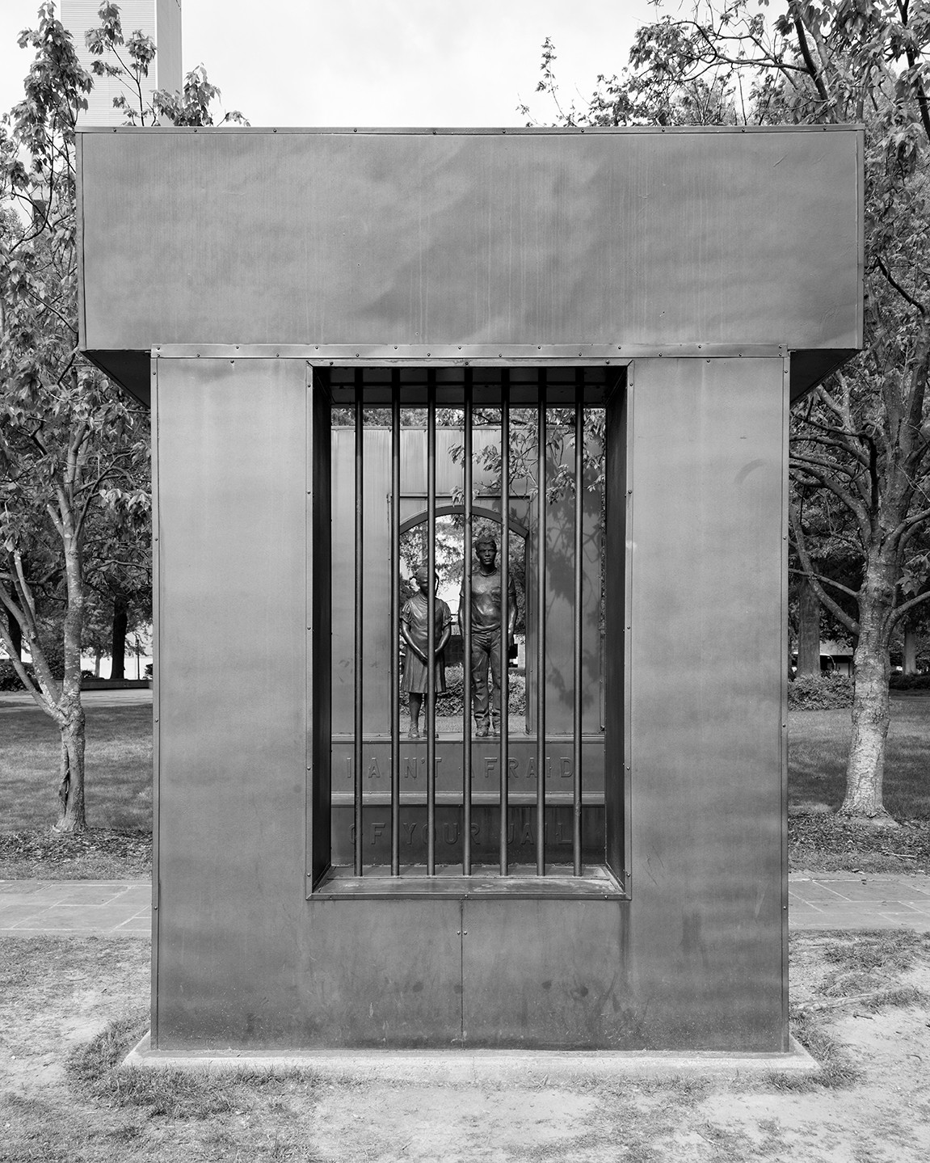
Our Vision

Slide 27
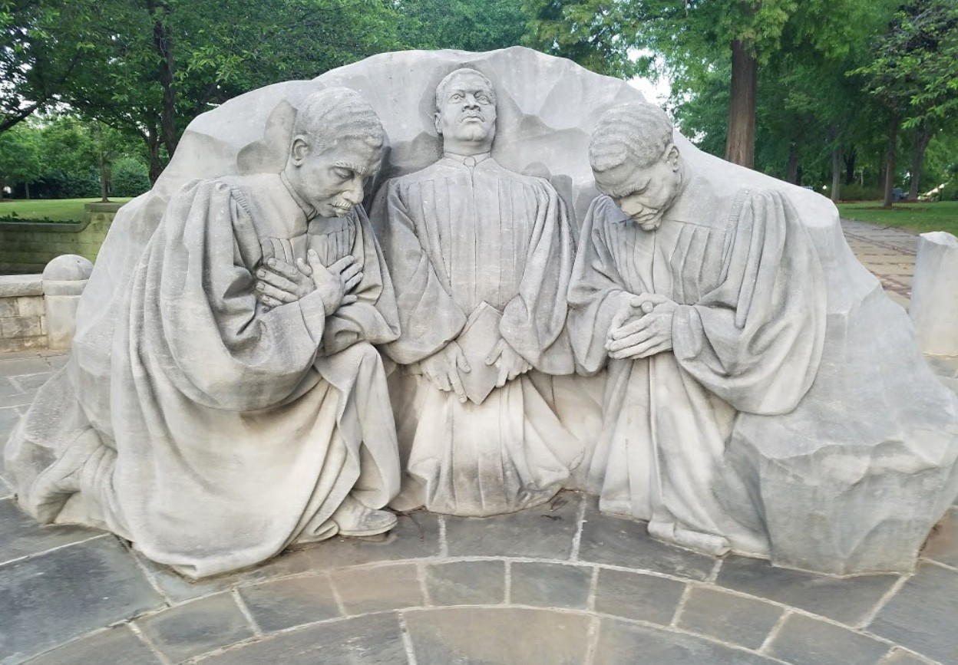
Our Vision

